Slide 1
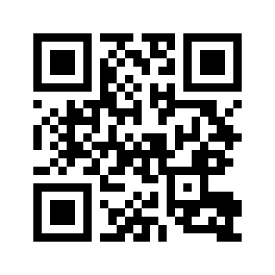
Fill in Attendance — edu.nl/pmc78
Warm-up Activity: 🏔️ The Snowball Sentence (groups of 4-5)
Get into groups of 4-5. Each group gets the same starter sentence.
Player 1 adds ONE element (adverb, phrase, clause) ANYWHERE in the sentence and says the full sentence aloud.
Player 2 adds another element and repeats the whole sentence.
Continue around the group. If you break the word order or forget part of the sentence, you're out.
Last person standing wins.

